Slide 1
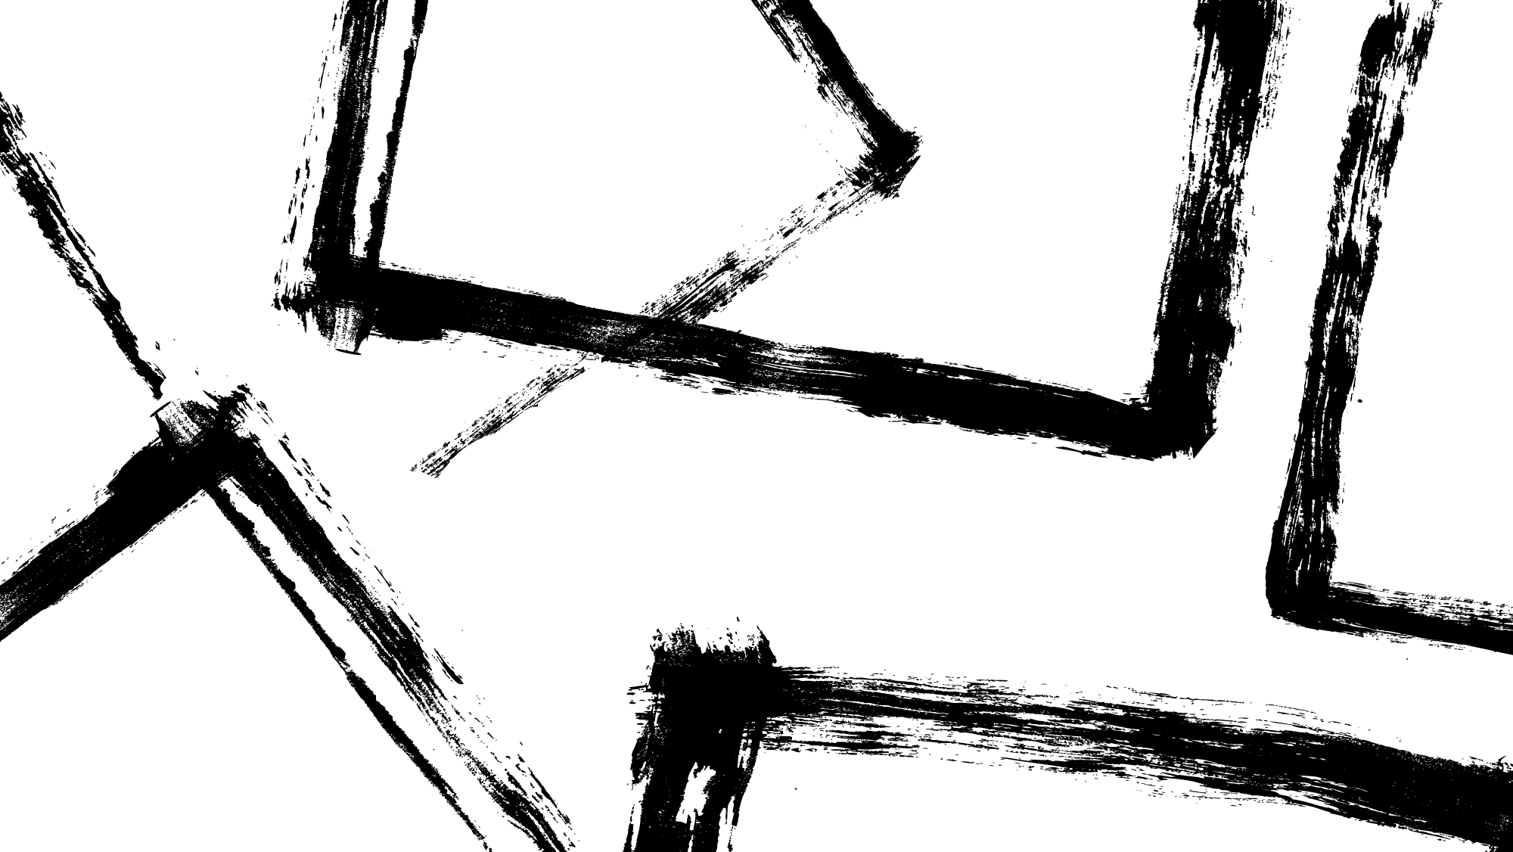
Nature Writing and the Brontë’s
A writing workshop delivered by Zakiya McKenzie
For The Brontë Parsonage Museum
August 3ʳᵈ 2023

Slide 2
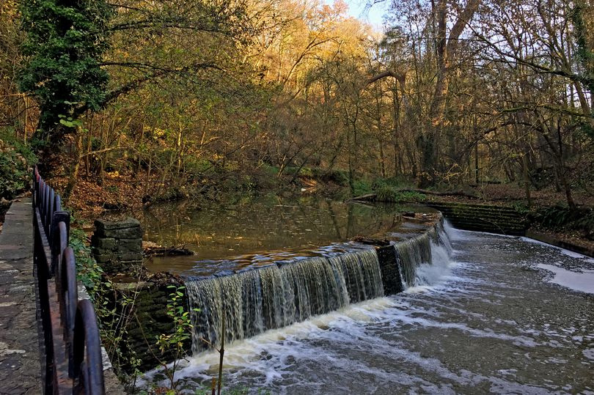
  Snuff Mills, Bristol

Slide 3
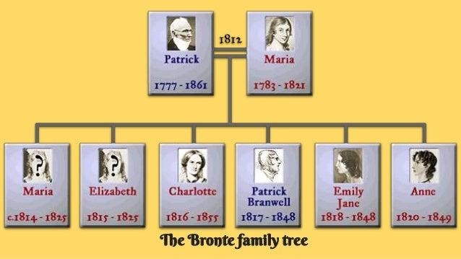

Slide 4
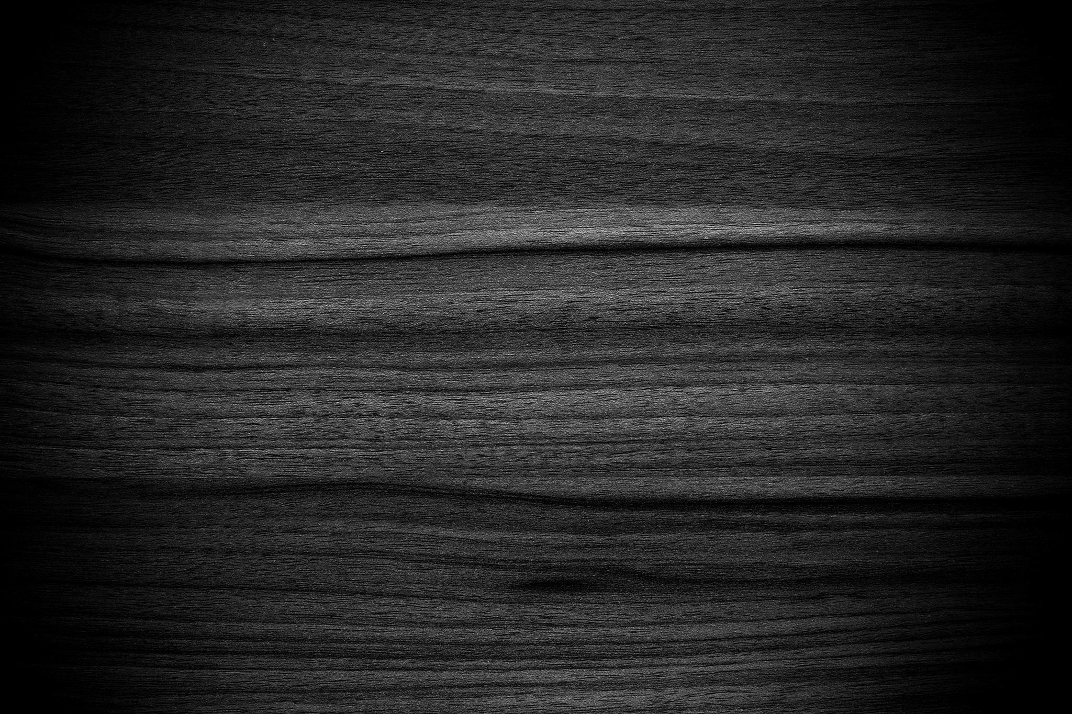
Natural History in Victorian Times

Slide 5
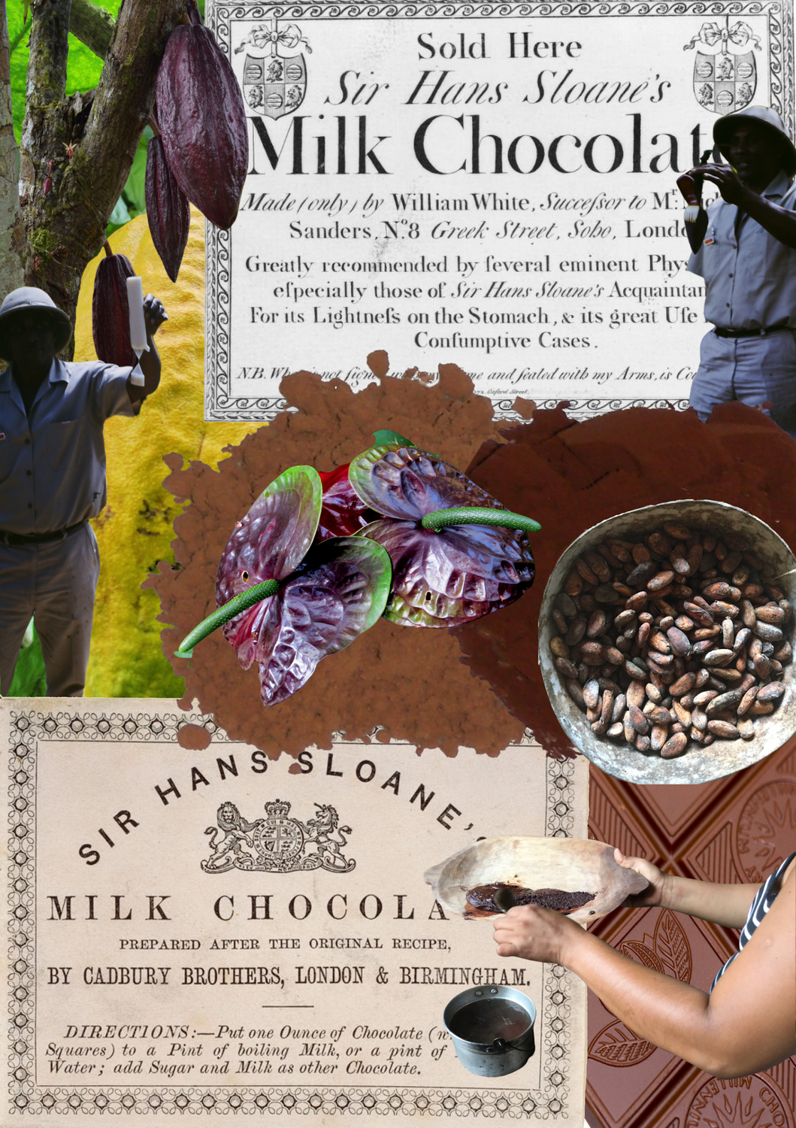
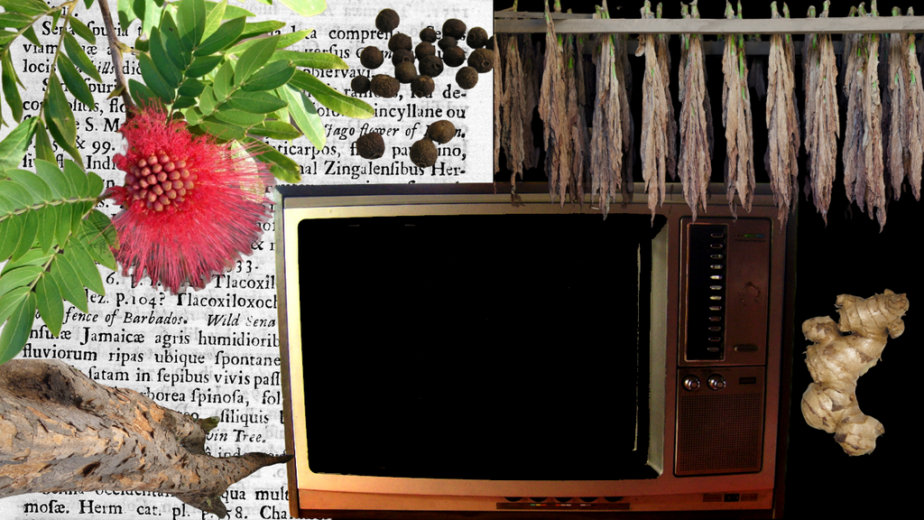
Zakiya McKenzie, 2022

Slide 6
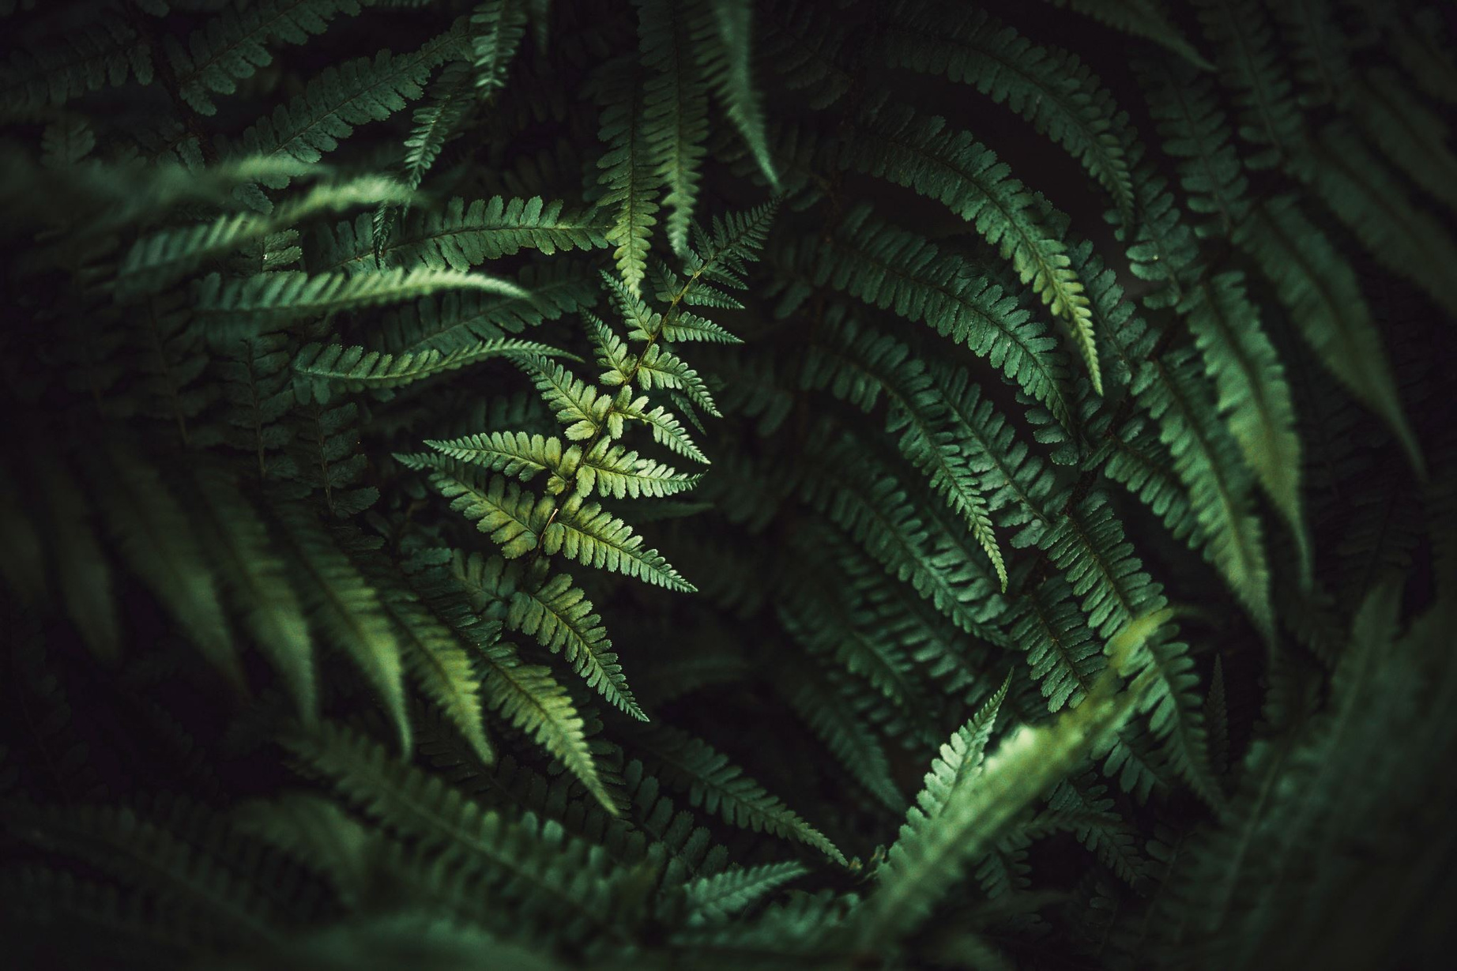
Pteridomania
  This term was coined to describe the widespread and passionate fascination with ferns that swept through Victorian society. Pteridomania led to a surge in fern collecting, cultivation, and the integration of fern motifs in various forms of art and design, making it a significant cultural phenomenon during that time.

Slide 7
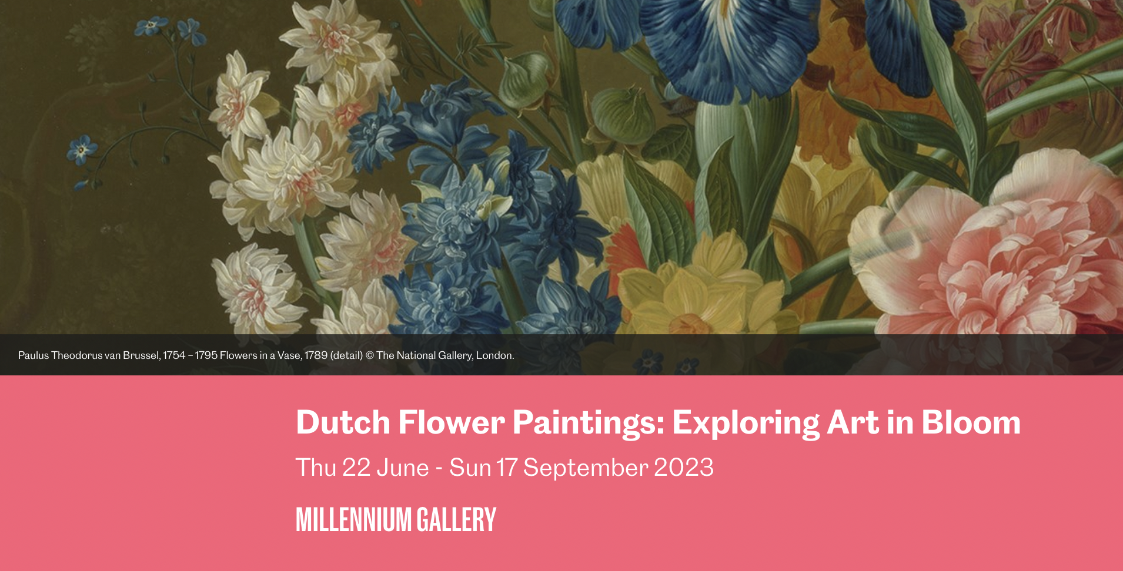

Slide 8
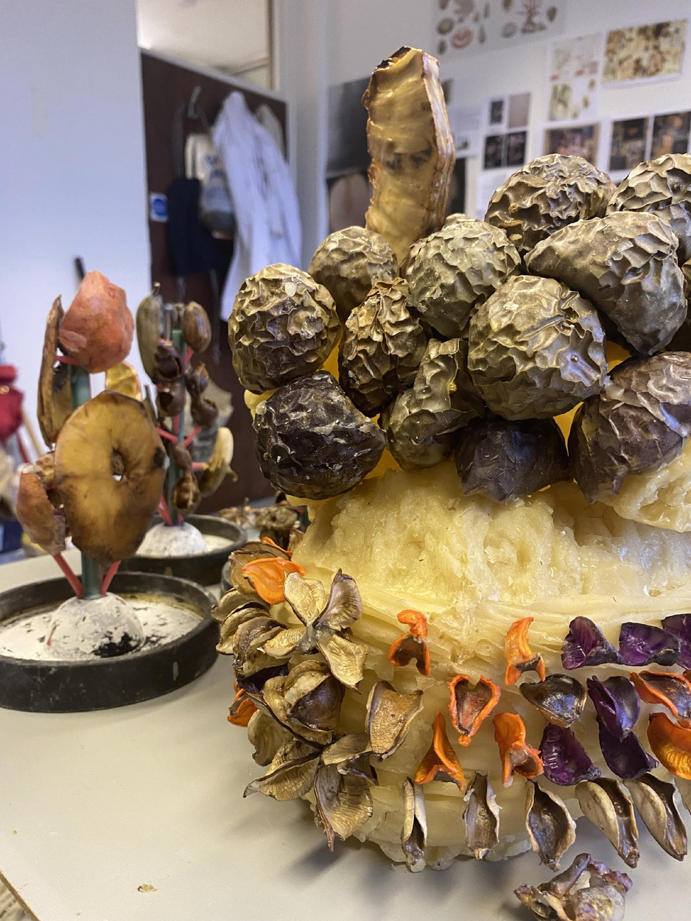
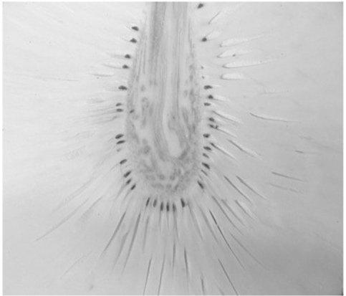
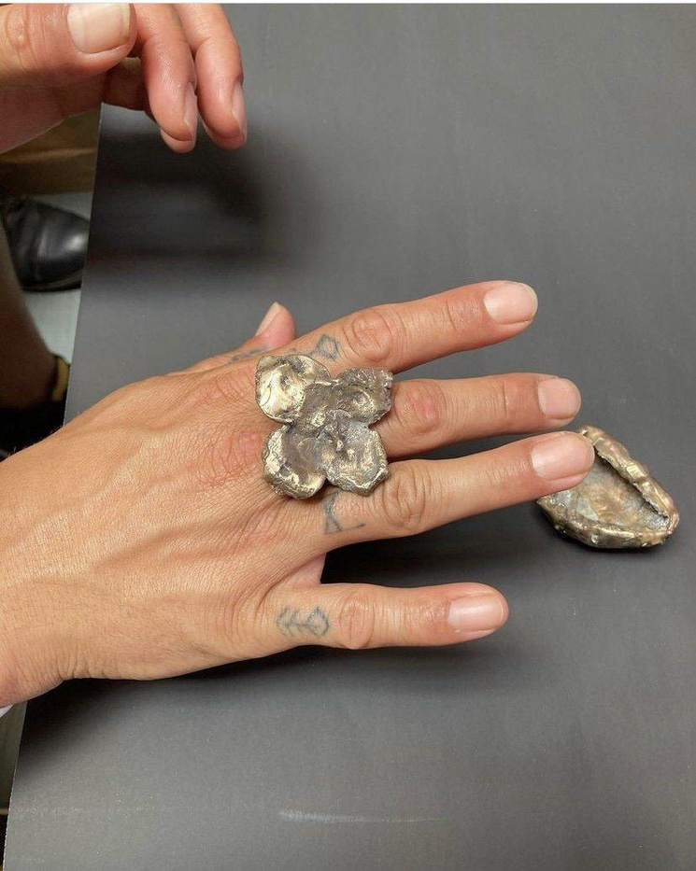
A Still Life In Transit: Of Pineapple, Cotton, Breadfruit with Dhaka Tulips and Further Specimens on Velvet
KEDISHA COAKLEY

Slide 9
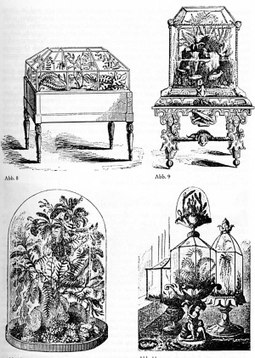
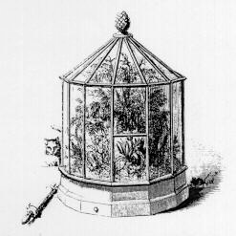
The Wardian Case

Slide 10
Natural History in the Brontë Home

Slide 11
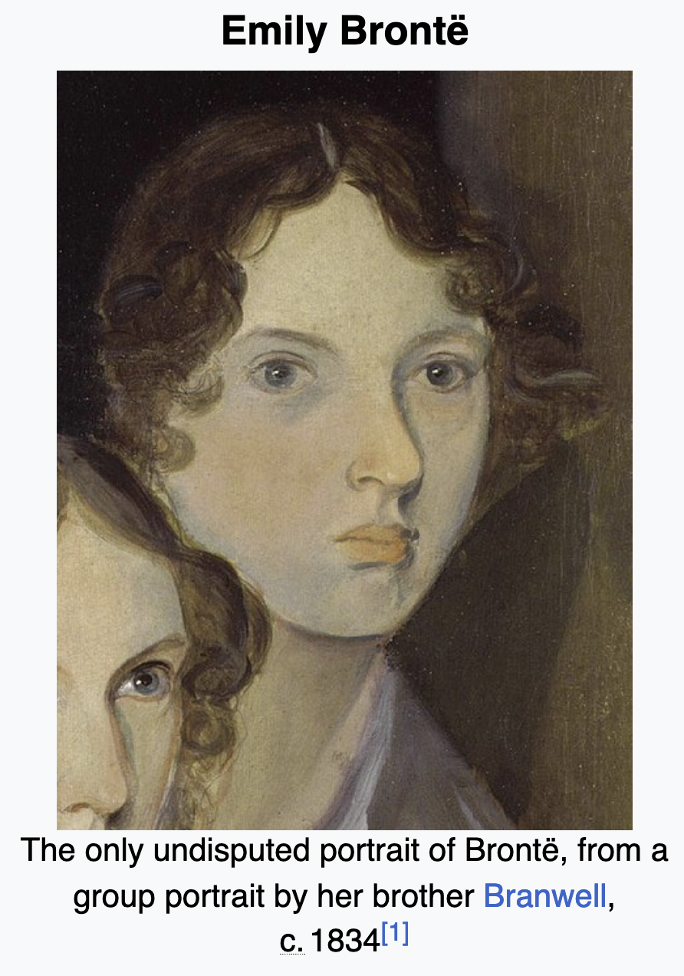
Devoir written by Emily Brontë in Brussels
The Butterfly,
1842
Notes:
https://kleurrijkbrontesisters.blogspot.com/2011/01/devoir-written-by-emily-bronte-in.html
https://docs.google.com/document/d/1nAK-QGfivJMM4l5Tt7QmHVRva9gNeYOOrnFsVtl_1l4/edit?usp=sharing
‹#›

Slide 12
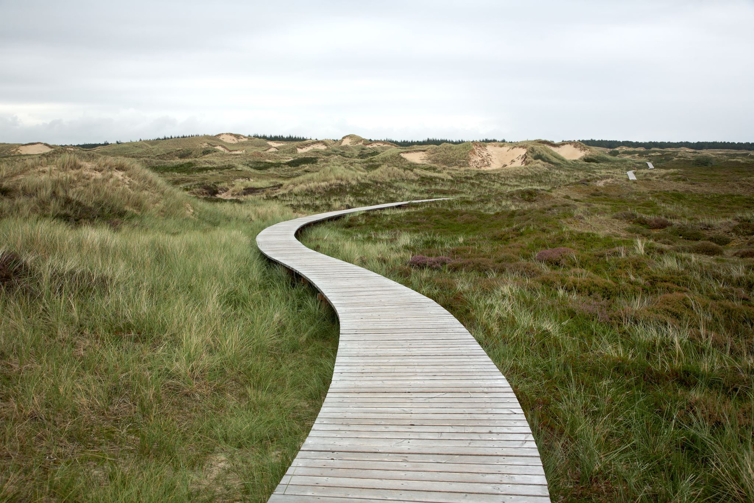
Weather and Place in Wuthering Heights
-Write a piece about a place/geography that is named to reflect the weather and action of the plot
- Can a native tongue or dialect help you describing a specific geography?
Notes:
https://www.lindasjohnston.com/a-natural-influence-nature-and-the-bronte-sisters/
https://docs.google.com/document/d/1rZKau3X-pSwk5wEDPxqZlETSzwWWYv2lZE0r8_25yzM/edit?usp=sharing
‹#›

Slide 13
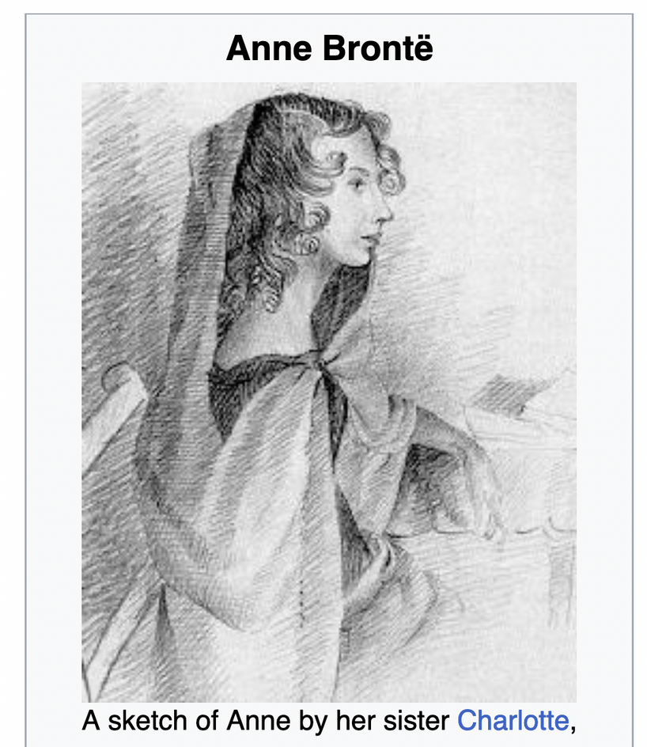

Flowers in the work of Anne Brontë
Notes:
https://allpoetry.com/poem/8457985-The-Bluebell-by-Anne-Bront%C3%AB
‹#›

Slide 14
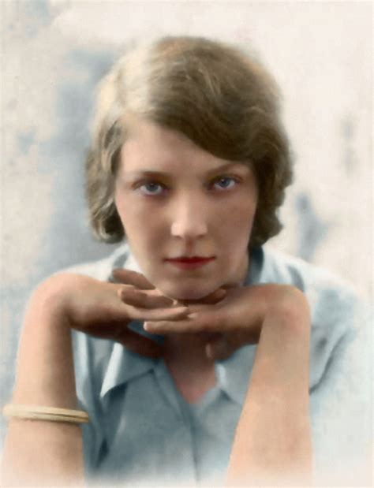
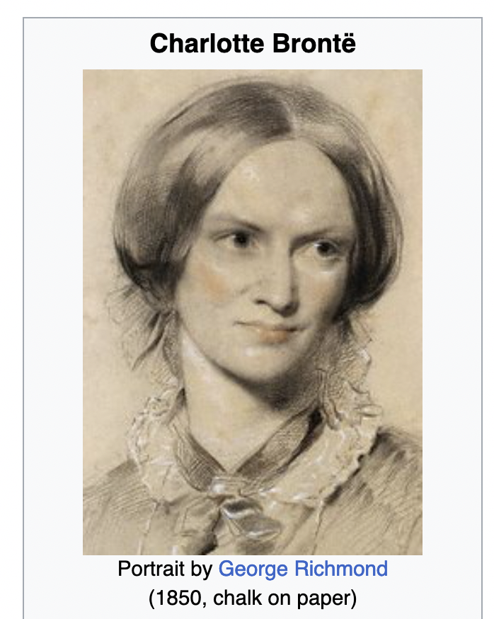
Jane Eyre and Wide Sargasso Sea
Jean Rhys

Slide 15
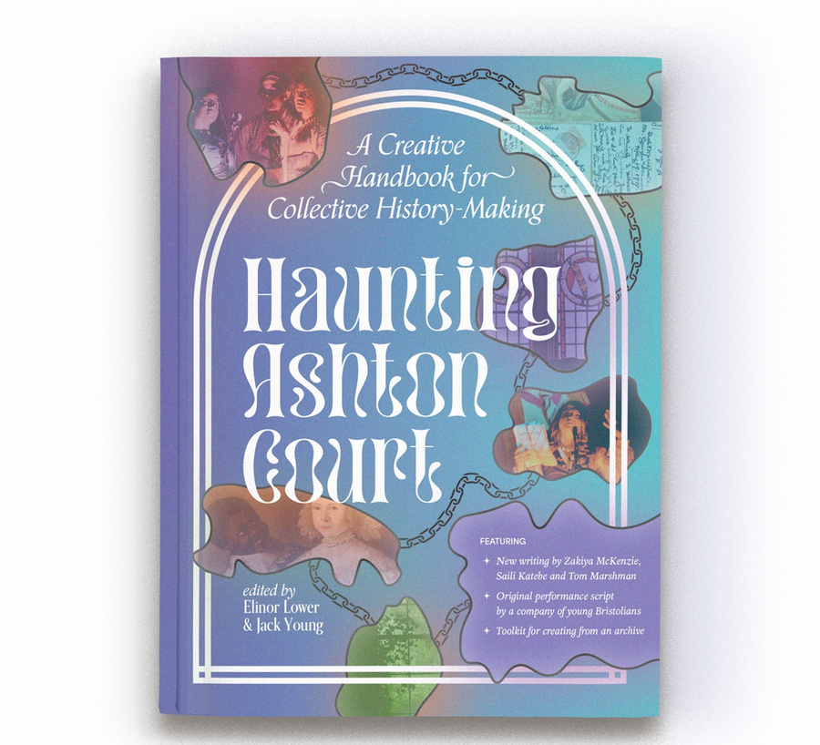
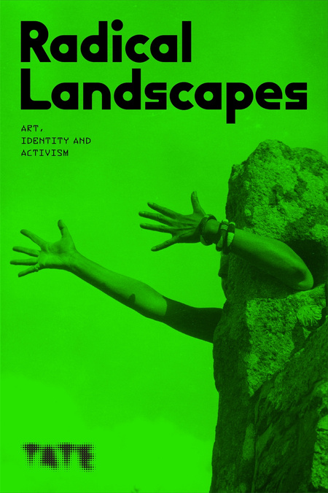
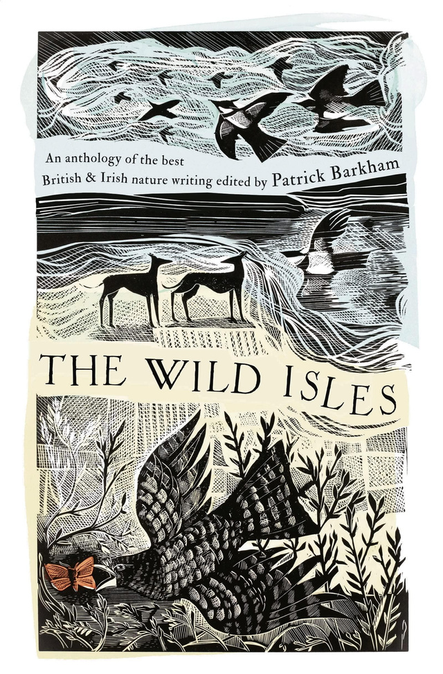
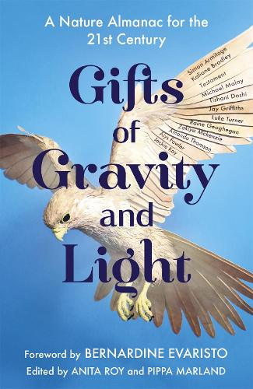
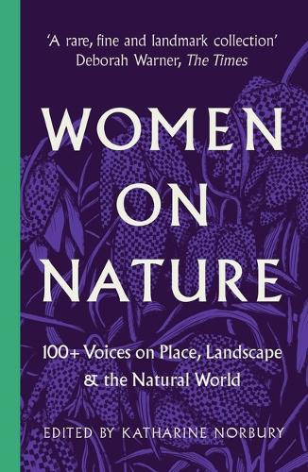
  THANK YOU! Look for my essays and stories in these anthologies

Slide 16
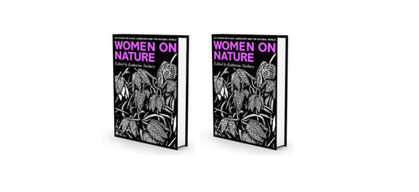
Women on Nature: 100+ Voices on Place, Landscape & the Natural World
Edited by Katharine Norbury
Includes
  Extract from Jane Eyre, Charlotte Brontë (1847)
  Poem ‘Stars’, Emily Brontë (1846)

